Slide 1
Operator

Slide 2
What is operator?
Operator is the symbol which is used to manipulate the values of operands.
Operand- It is the quantity or object on which operation is performed.
Consider the expression 2+3=5. Here 2 and 3 is operand and the + is operator.

Slide 3
Types of operator :
Python language supports the following types of operators :
Arithmetic operators
Comparison operators
Assignment operators
Logical operators
Bitwise operators
Membership operators
Identity operators

Slide 4
Arithmetic operators
Arithmetic operators are used to perform arithmetic operations between two operands
It includes addition (+), subtraction(-),multiplication(*), divide(/), modulus division/remainder(%), floor division(//), exponent(**)

Slide 5
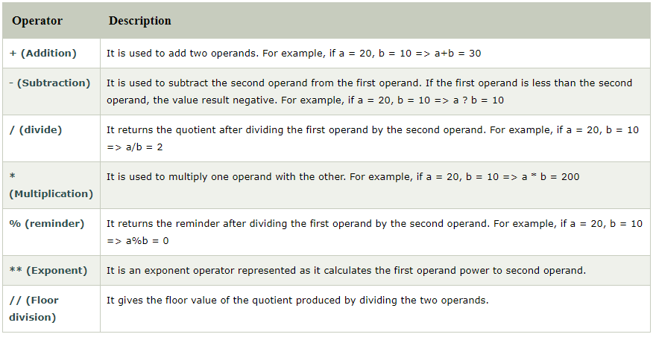
Consider the following table for detailed explanation for arithmetic operators :

Slide 6
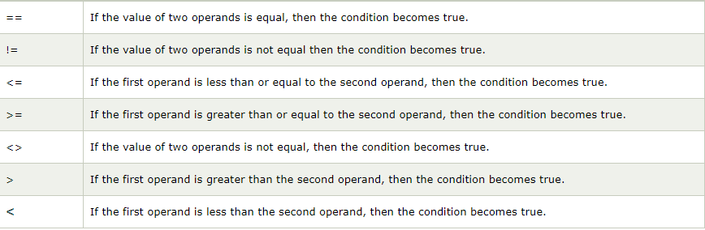
Comparison operator : are used to comparing the values of two operands and return Boolean(true / false ) value accordingly.

Slide 7
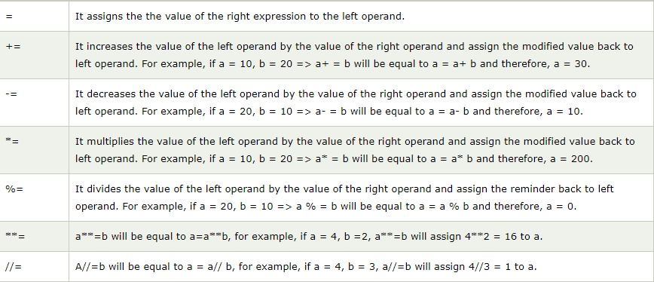
Assignment operators – The assignment operators are used to assign the value of the right expression to the left operand.

Slide 8
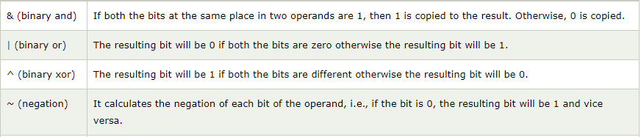
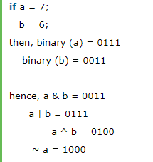
Bitwise operator – Perform bit by bit operation on the values of two operands.
Example :

Slide 9
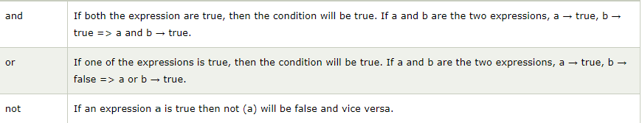
Logical Operators : are used primarily in the expression evaluation to make decision. It results Boolean value(true / false)

Slide 10
Membership Operators : are used to check the membership of value inside a data structure. If the value is present in the data structure , then the resulting value is true otherwise false.

Slide 11
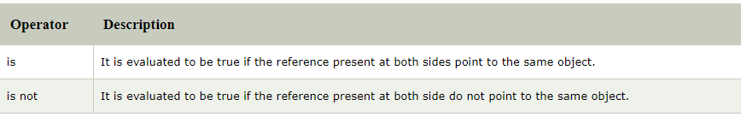
Identity Operators :

Slide 12
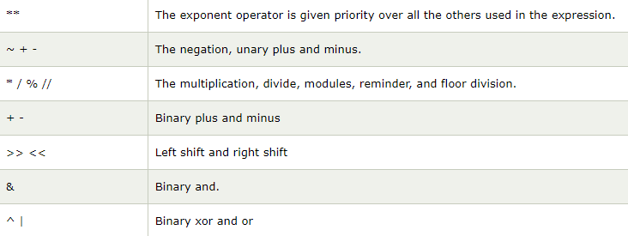
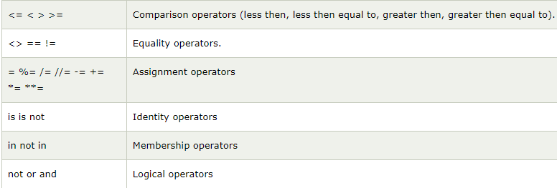
Operator Precedence : is important to find out since it enables us to know which operator should be evaluated first.

Slide 13
Comments: are the human readable notes in the program that are ignored by interpreter.
They make program much more readable, you should get into the habit of doing it.
Python supports two types of comment :
Single line comment – For single line comment, user must start with # .
Example : # This is single line comment
print( ‘Hello python’)
Multi line comment – For multi line comment, user must start with triple quotes
Example : ‘’’ This is multi
line
comment ‘’’

Slide 14
What are Boolean in python?
Boolean values are the two constant objects False and True.
They are used to represent truth values (other values can also be considered false and true).
In numeric contexts (for example, when used as the argument to an arithmetic operator), they behave like the integers o and 1, respectively.
The built-in function bool( ) can be used to cast any value to a Boolean, if the value can be interpreted as a truth value.
They are written as false and true, respectively.

Slide 15
Truth-Table :
For compound conditionals, we can create a truth table that lets us see which bits must evaluate as true before the compound is held to be true.
You should construct one of these for every compound conditionals that has more than two compounds.
The more compounds it has, the harder it is for humans to understand
The basic truth tables for a two compound condition follow.

Slide 16
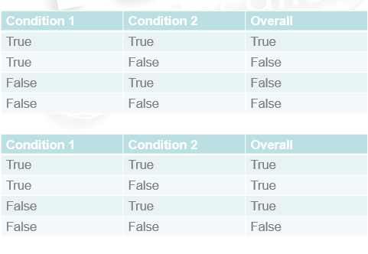
Truth-table for or
Truth-table for and

Slide 17
Truth Table construction:
You will need a number of rows in your table equal to 2^n, where n is the number of compounds you have.
Fill the table with all the various combinations of true and false..
Fill the table with all the various combinations of true and false.
Use this to work out the answer to each of the possible sets of data.
You can then use this table when evaluating Compound conditionals.

Slide 18
Constructing a Truth Table :
Make sure you cover all possibilities.
There is an easy way to get all of the possible combinations of true and false.
Begin with your first column.
Make it half T(True) and half (false)
Move on to your next column
Divide into quarters, alternating T and F
Move on to the next
Each time, half and then alternate.

Slide 19
If there are three compounds :
A | B | C
T
T
T
T
F
F
F
F

Slide 20
A | B | C
T | T
T | T
T | F
T | F
F | T
F | T
F | F
F | F

Slide 21
A | B | C
T | T | T
T | T | F
T | F | T
T | F | F
F | T | T
F | T | F
F | F | T
F | F | F
Compound condition
Results…
..........
…….
…….
……..
……..
……..
……..

Slide 22
Short – Circuit Operators:
Stop computing when they know the answer
A=2 , b=3
(A<B) or (B<A) -→ True or …… --→ true
Go to python terminal and type :
>>> True or (1/0)
It gives → True
>>> False and g where g is unassigned_variable
It gives -→ False

Slide 23
Work out :
Truth table for A and (B or C)
Truth table for (A and B) or C
Truth table for (A and B)
Truth table for (A or B)
Truth table for (A or B) and C

